Slide 2

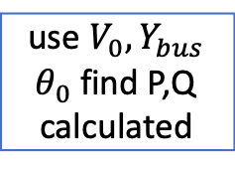
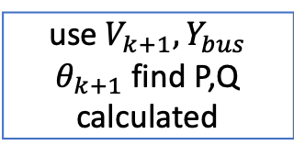
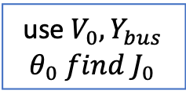
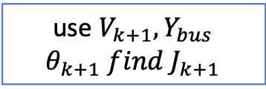
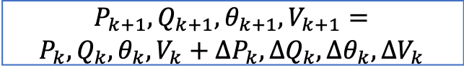
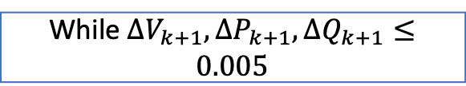
runpf(),find a feasible points
use $V_{0}, Y_{bus}$ $θ_{0}$ find P,Q calculated
use $V_{0}, Y_{bus}$ $θ_{0} find J_{0}$
Set up linprog
While $∆V_{k+1},{∆P}_{k+1},∆Q_{k+1}≤0.005$
$P_{k+1},Q_{k+1},{θ_{k+1},V}_{k+1}=$ $P_{k},Q_{k},{θ_{k},V}_{k}+{∆P}_{k},∆Q_{k},{∆θ}_{k},∆V_{k}$
use $V_{k+1}, Y_{bus}$ $θ_{k+1}$ find P,Q calculated
use $V_{k+1}, Y_{bus}$ $θ_{k+1} find J_{k+1}$
Set up linprog and get ${∆P}_{k+1},∆Q_{k+1},{∆θ}_{k+1},∆V_{k+1}$

